Slide 1
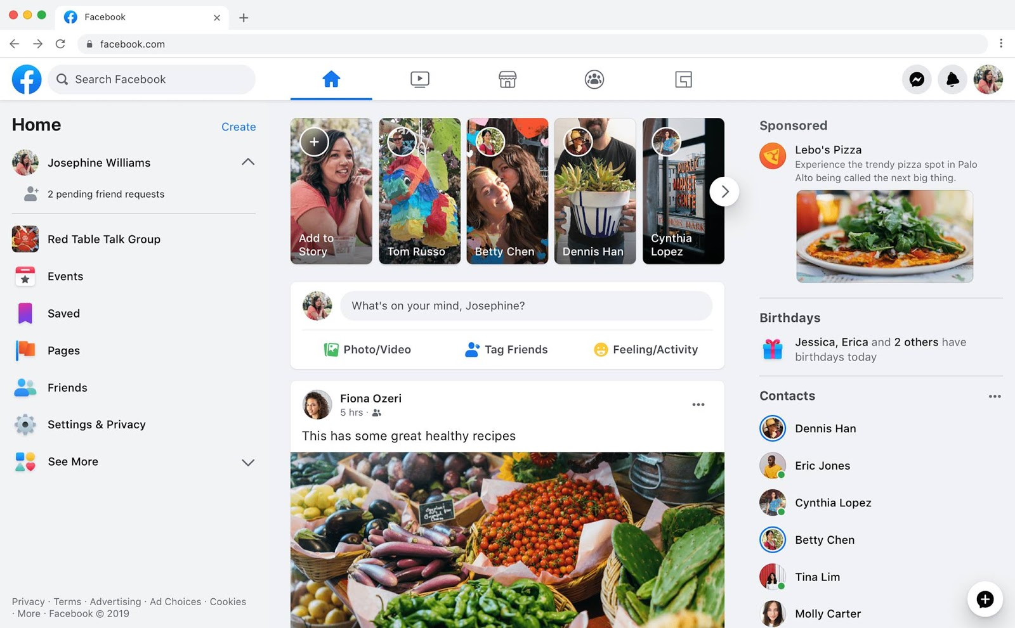
Identify root components of website below

Slide 2
Display: flex;
Nav
div

Slide 3
Menu bar
Nav-left
Nav-cener
Nav-right
display: flex;
Justify-content: space-around;
icon
icon
title
icon
icon
icon
icon
icon
icon
icon
icon

Slide 4
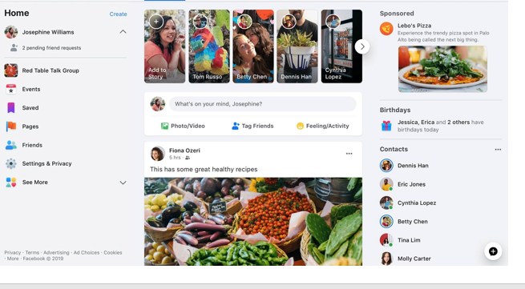
container
display: flex;
Justify-content: space-around;
Div-left
Div-cener
Div-right

Slide 5
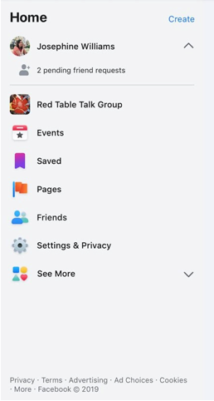
Container> aside left
div
Display : flex;
Flex-direction: column;
div
Display : flex;
Justify-content: flex start;
div
div
Display : flex;
Flex-direction: column;
Display : flex;
Justify-content: flex start;
div

Slide 6
Container> aside left
title
title
icon
title
icon
icon
title
icon
title
icon
title
Display : flex;
Flex-direction: column;
icon
title
icon
title
icon
title
icon
title
icon
title
icon
title

Slide 7
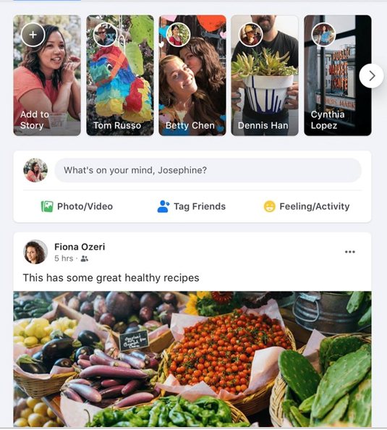
Container> content
div
div
Display: flex;
Flex-direction: column;
div

Slide 8
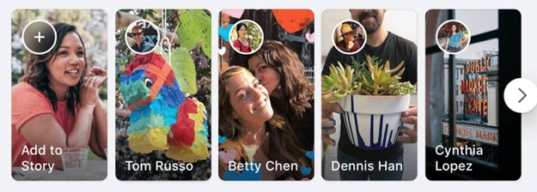
Container> content>menu bar
Display: flex;
Justify-content: space-around;
div
div
div
div
div

Slide 9
Container> content>menu bar
icon
icon
icon
icon
icon
icon
title
title
title
title
title
Display: flex;
Flex-direction: column:

Slide 10
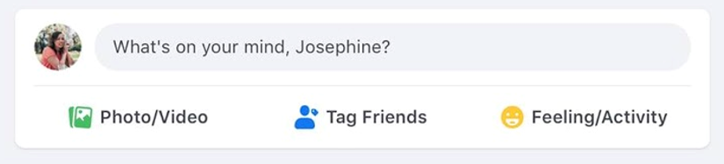
Container> content>menu bar
div
div
Display: flex;
Flex-direction: column;

Slide 11
Container> content>menu bar
div
div
div
div
Display: flex;
Justify-content: flex-start;
Display: flex;
Justify-content: space-between;
icon
title
icon
title
icon
title
icon
title

Slide 12

Container> content
Display: flex;
Flex-direction: column;
div
div
div

Slide 13
div
div
div
icon
title
icon
icon
title
icon

Slide 14

Main post

